Slide 1
In Vehicle Coupon Recommendation
—Data Science Capstone Project Presentation
Shixin Li
05/28/2021

Slide 2
Contents
Problem Statement
Data Information
Exploratory Data Analysis
Data Pre-processing
Model Selection
Conclusion

Slide 3

Problem Statement

Slide 4
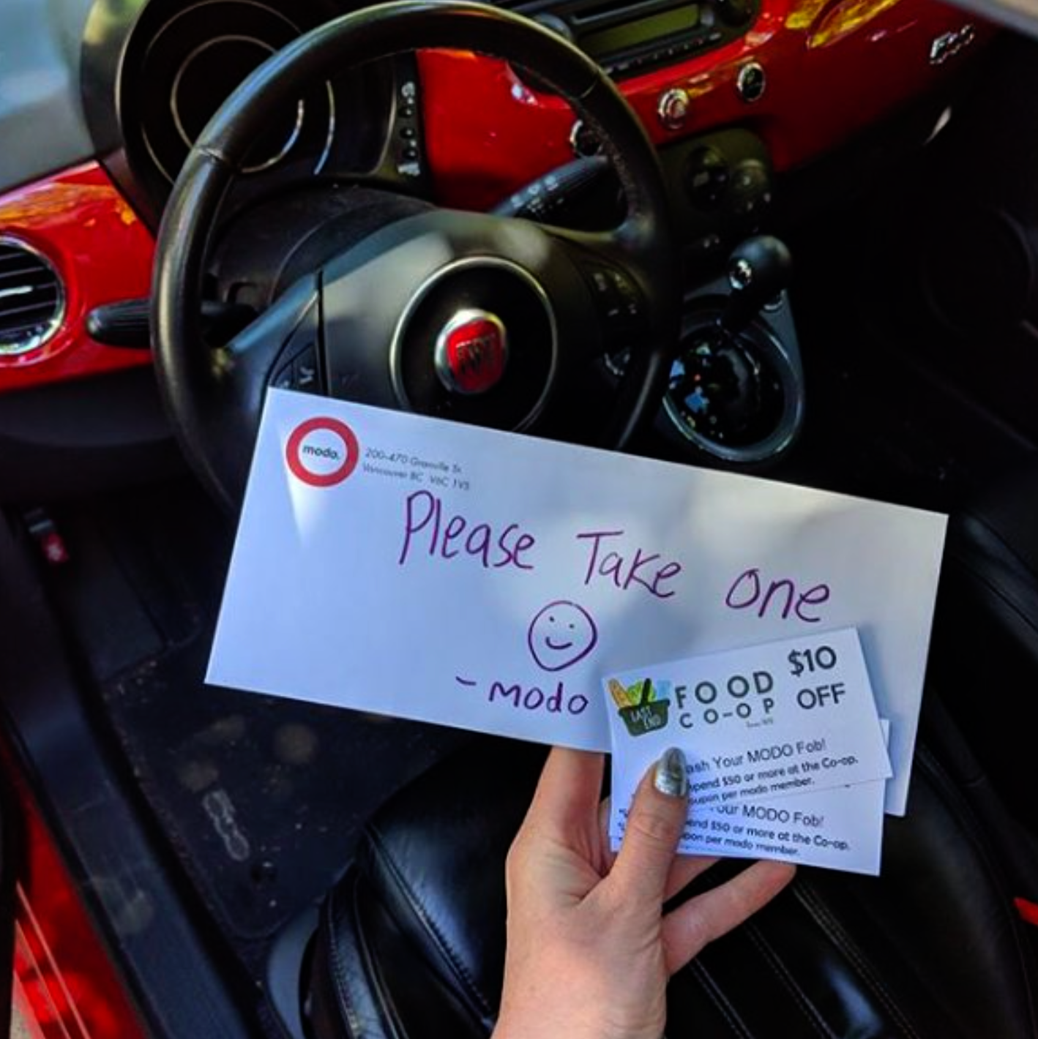
What is the problem?
In what a driving scenario, people would accept the recommended catering coupon?

Slide 5



Who Care About this Problem?
Catering Business
* Restaurant
* Coffee Shop
* Bar
…...

Slide 6
What to do?
Create supervised learning models to predict who would accept the recommended coupon in vehicle
Criteria for success: Achieving at least 80% accuracy

Slide 7

Data Wrangling

Slide 8
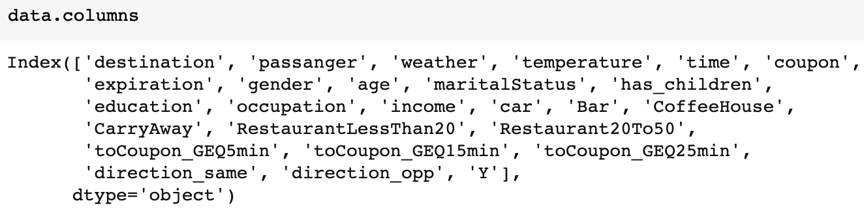
Data Information
Collected via a survey on Amazon Mechanical Truck
12684 observation, 26 columns with 1 column as label Y
All features are categorical type
Column name:

Slide 9
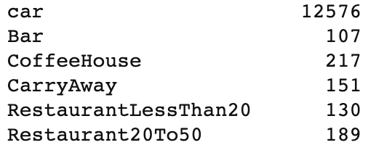
Data Cleaning
Missing Values:
99.1% of values in the column ‘care’ are missing, remove this column
4.8% observations have missing values, remove these rows
Column with unique value:
* ToCouponEGQ5min
Remove this column
74 rows of duplicate rows
Remove these 74 rows
After this sept, 12007 rows and 24 columns are left in the data set.

Slide 10

Data Exploratory Analysis

Slide 11
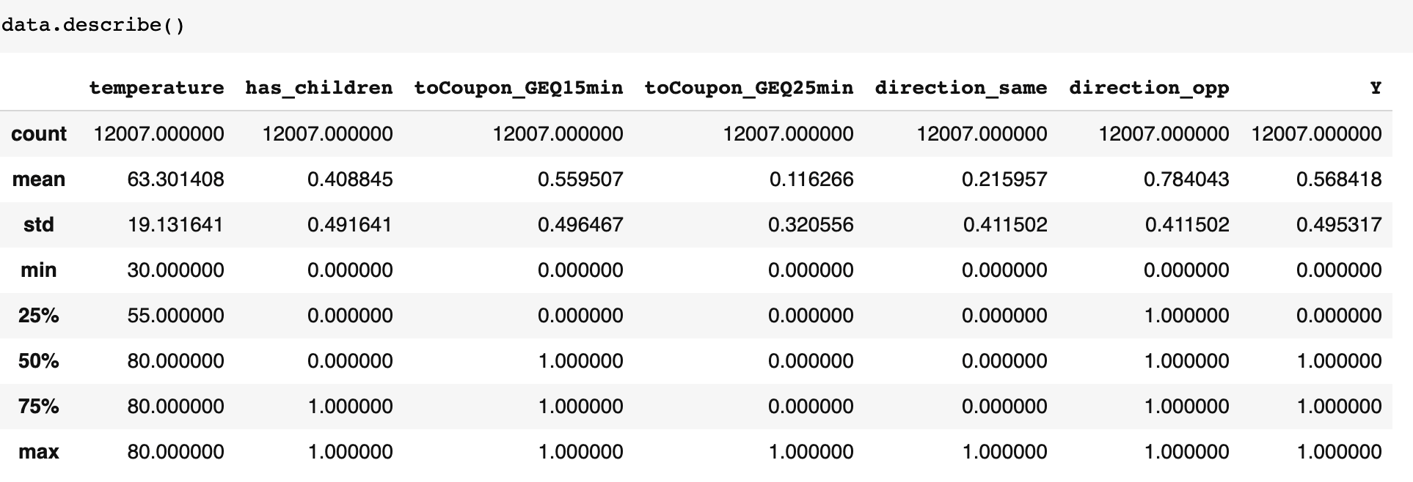
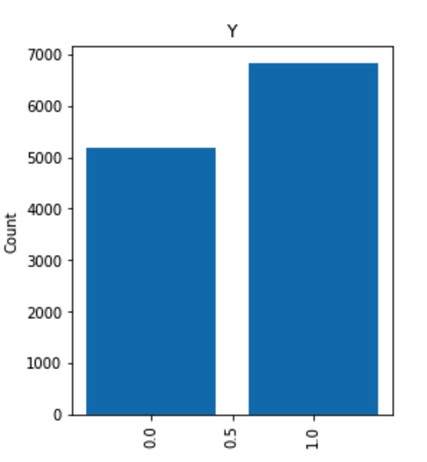
EDA — Statistical Data
For using the coupon, usually more than 25 mins to drive, not at the same direction as the destination, and the weather is higher than 55 Fahrenheit.
56.7% of data are labeled 1 and 43.3% are labeled 0

Slide 12
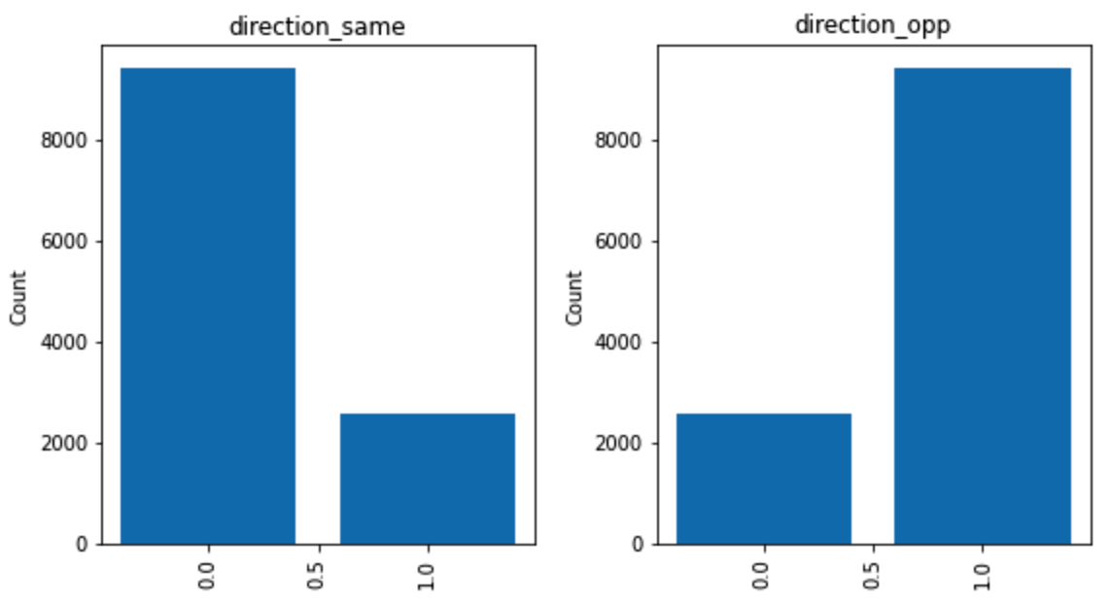
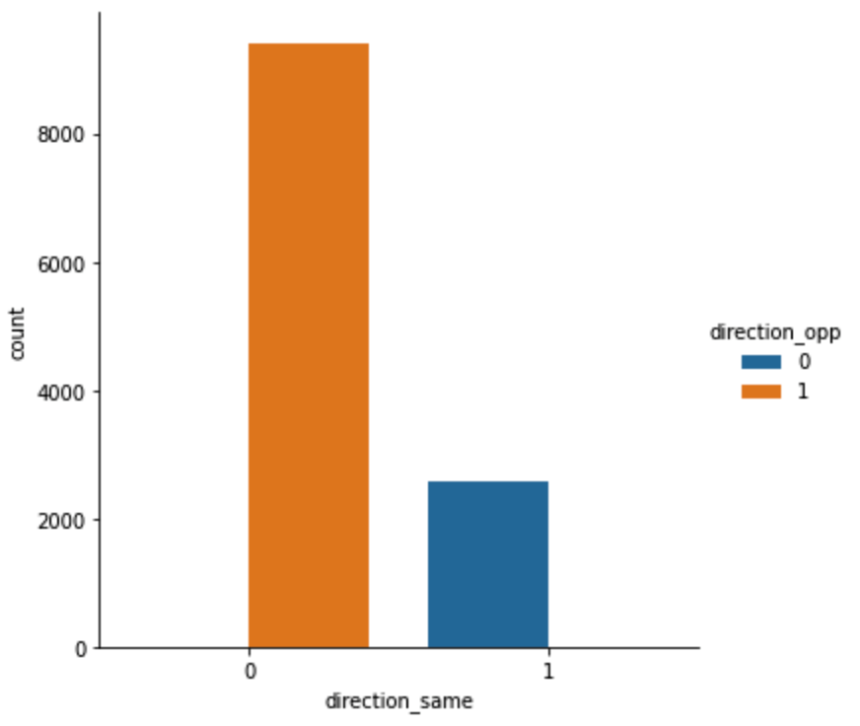
EDA—Data Visualization
From the plot above, we can see that the feature ‘direction_same’ and ‘direction_opp’ are indicating the same fact, so we should remove one of them.

Slide 13
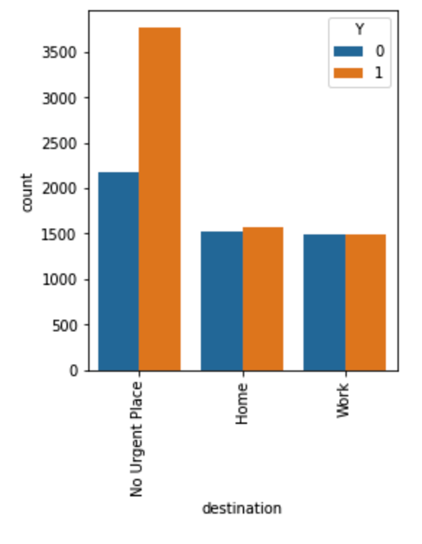
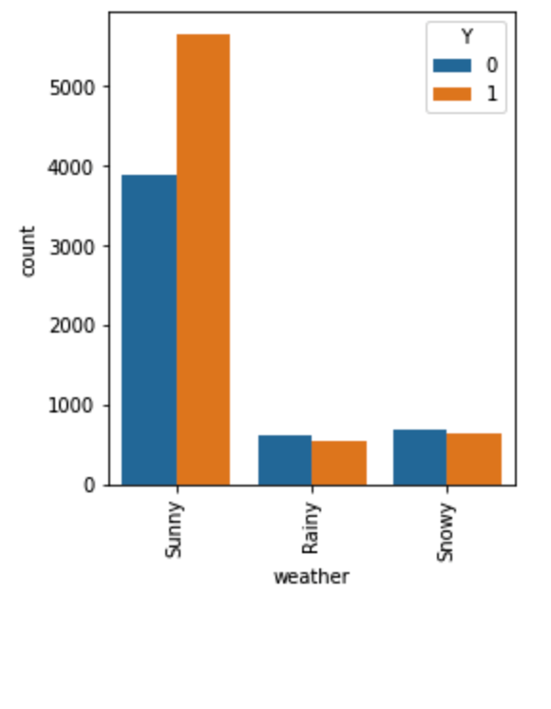
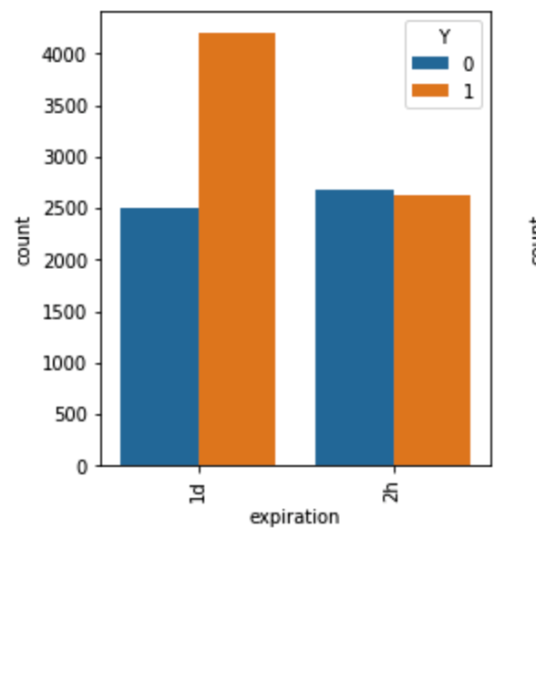
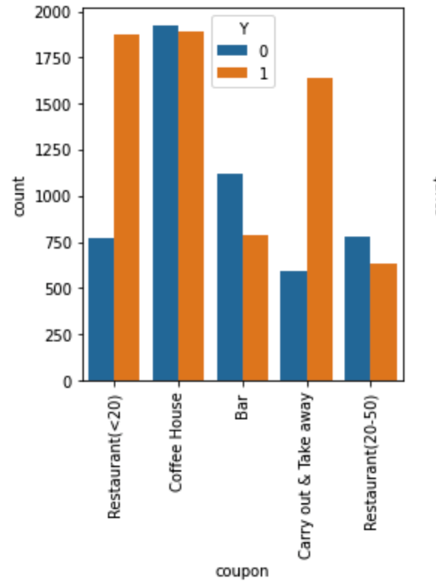
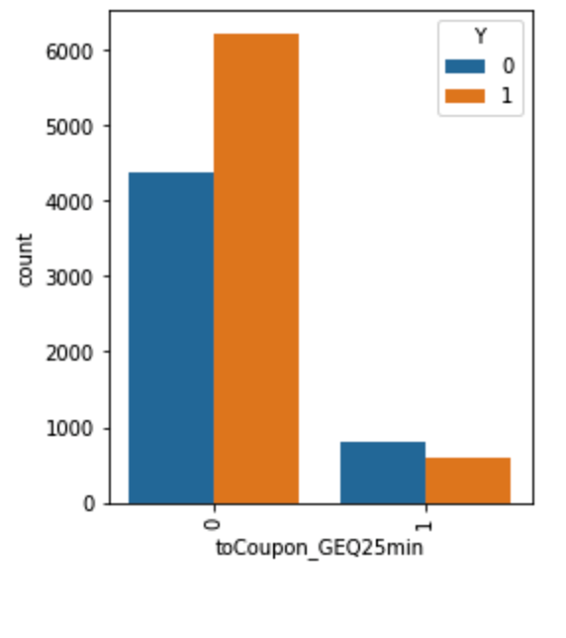
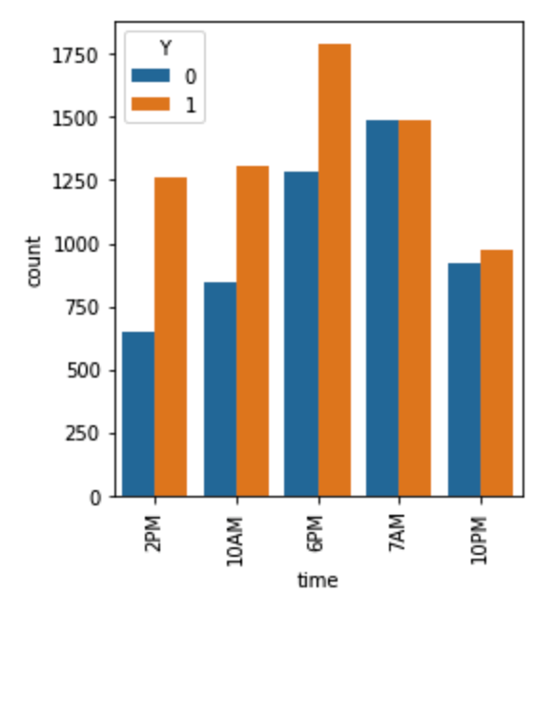
EDA—Data Visualization
People are more likely to use the coupon when they are going to not urgent place, in sunny day, the coupon will expiration sooner, the coupon for restaurant and take away, driving distance is less than 25 mins, in the afternoon.

Slide 14

Data Pre-processing

Slide 15
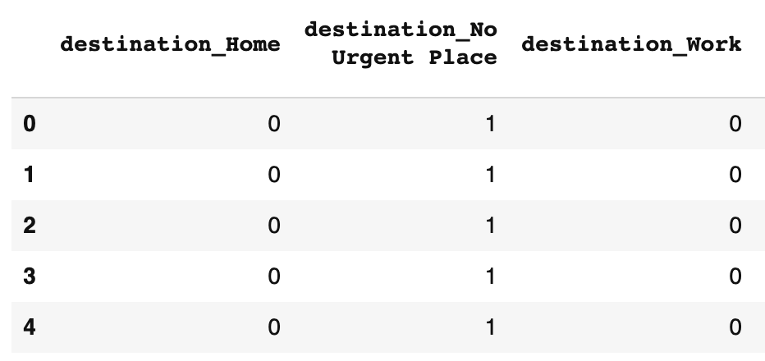
Create Dummy Variables
After the process of EDA, the data set has 12007 rows and 24 columns.
All features are categorical type, then transfer all of them to dummy variables
After the transformation, the data set now has 113 columns
Then split the data into training and test set with test size ratio 0.2, now the data is ready for training the model.

Slide 16

Model Selection

Slide 17
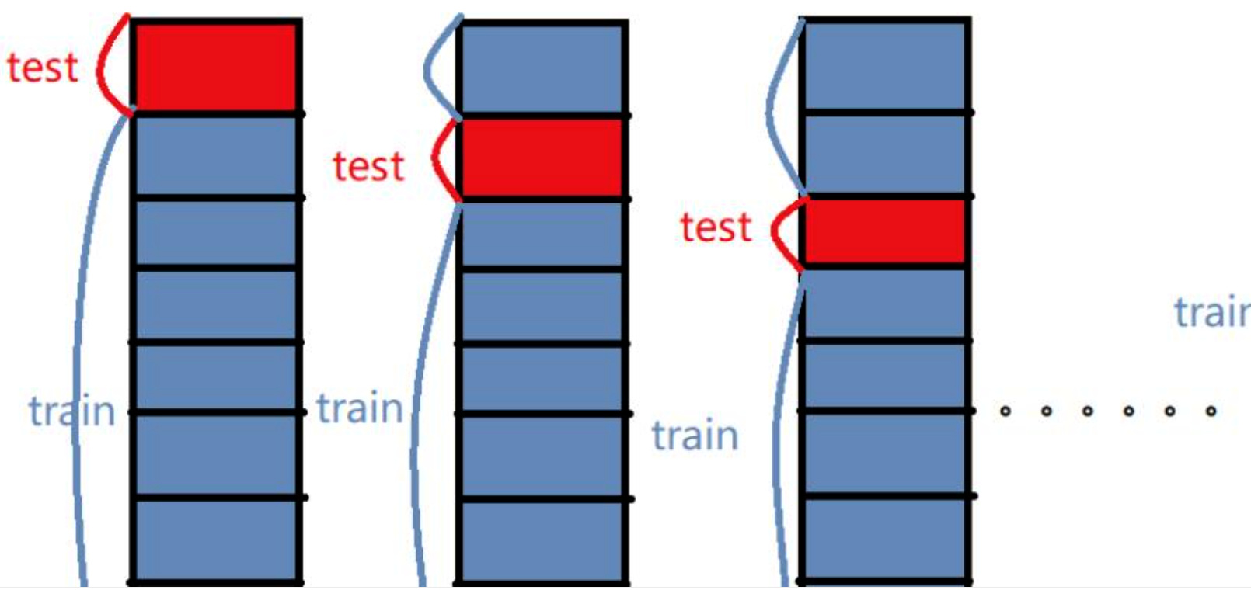
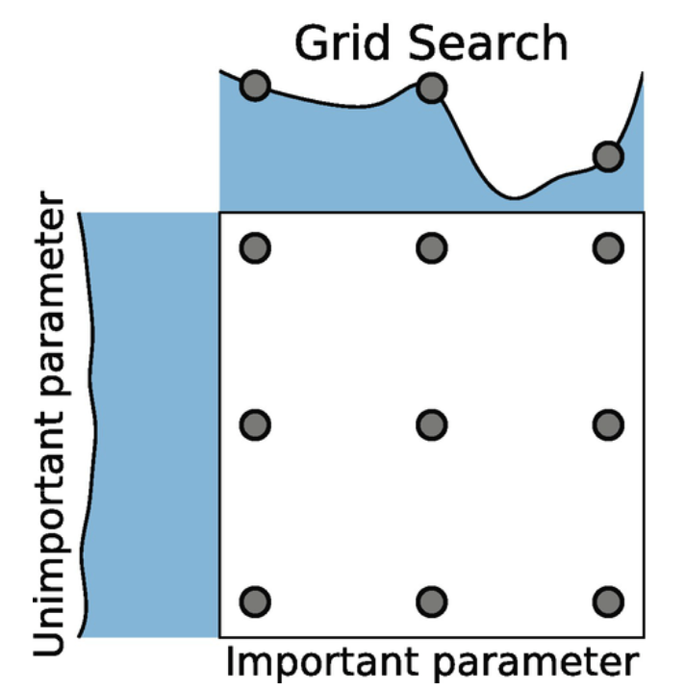
Model Training & Grid Search CV
Supervised Learning Models:
Logistic Regression, Random Forest, K-nearest Neighbors, Support Vector Machine, Naive Bayes, Gradient Boosting
Hyperparameter Optimization：
Grid Search Cross Validation
Metric:
F1-score

Slide 18
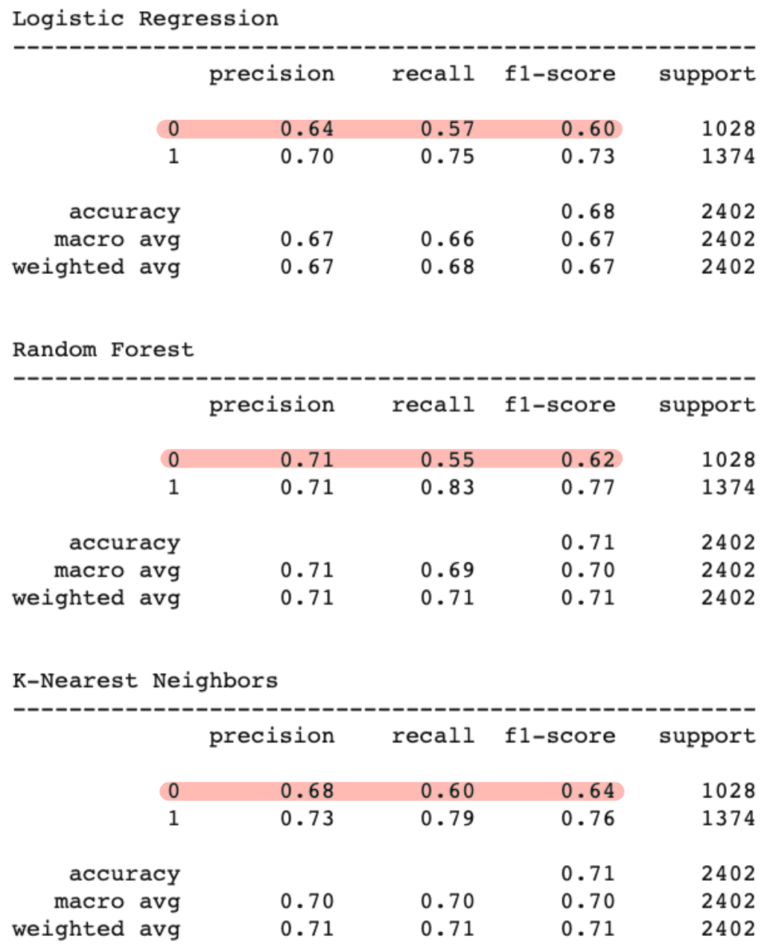
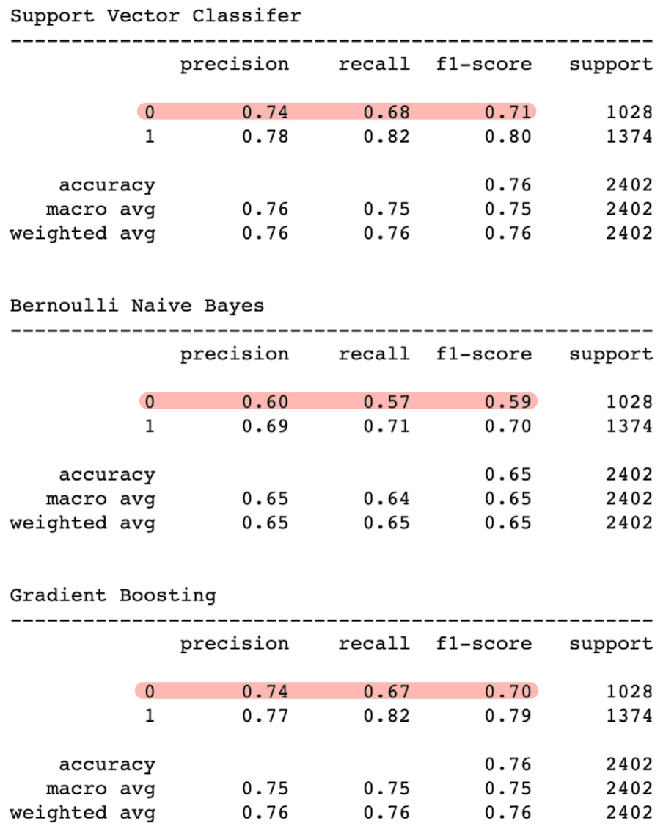
Result: F1-score and Accuracy
All model have lower f1-score on negative than positive.
Naive Bayes model has the lowest f1-score and accuracy
Support Vector Classifier has the highest f1-score, 0.755
Support Vector Classifier and Gradient Boosting have the same accuracy, 76%.

Slide 19
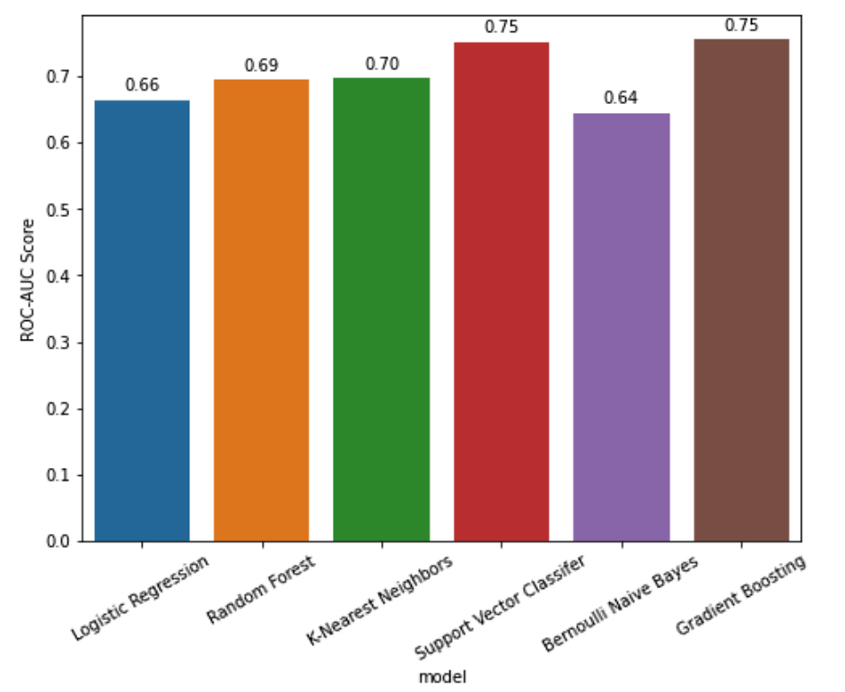
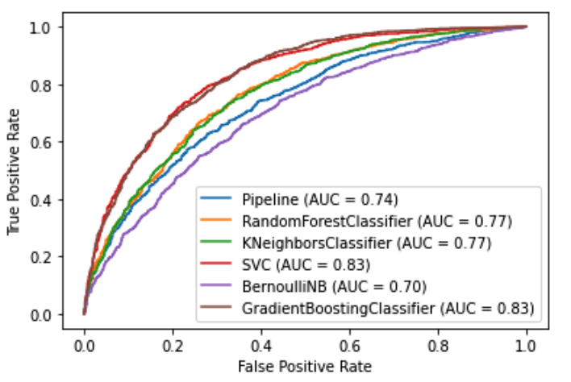
Result: ROC-AUC Score & AUC Value
Support Vector Classifier Gradient Boosting have the same ROC-AUC Score and AUC Value, 0.75 and 0.83, they are better than 4 models.

Slide 20

Conclusion

Slide 21
Conclusions：
Base on the f1-score, ROC-AUC score and ROC-AUC value, Support Vector Classifier(SVC) is the best model for the In Vehicle Coupon Recommendation Data Set
All features, total 112 dummy variables, are applied to the SVC
The accuracy and f1-score of SVC are 76% and 0.755, they are very close to the GB model
None of the model achieved the Criteria for success, a accuracy of 80%

Slide 22

Ideas for Further Research
Consider how much people usually spent in meal or drinking
Where people are living in, urban or rural areas
What kind of food, drink or alcohol they prefer
A similar research can also applied on the big supermarket, which can help them allocate the commodity and arrange the shops better

Slide 23
The End!!!!!
Thank you for watching!!!!

